Slide 1
Data Mining and Data Warehousing

Slide 2
Data Mining and Data Warehousing
Decision Support Systems
Data Warehousing
Data Mining
Classification
Clustering

Slide 3
Decision Support Systems
Decision-support systems are used to make business decisions, often based on data collected by on-line transaction-processing systems.
Examples of business decisions:
  What items to stock?
  What insurance premium to change?
  To whom to send advertisements?
Examples of data used for making decisions
  Retail sales transaction details
  Customer profiles (income, age, gender, etc.)

Slide 4
Decision-Support Systems: Overview
Data analysis tasks are simplified by specialized tools and SQL extensions
  Example tasks
    For each product category and each region, what were the total sales in the last quarter and how do they compare with the same quarter last year
    As above, for each product category and each customer category
Statistical analysis packages (e.g., : S++) can be interfaced with databases
  Statistical analysis is a large field, but not covered here
Data mining seeks to discover knowledge automatically in the form of statistical rules and patterns from large databases.
A data warehouse archives information gathered from multiple sources, and stores it under a unified schema, at a single site.
  Important for large businesses that generate data from multiple divisions, possibly at multiple sites
  Data may also be purchased externally

Slide 5
Data Warehousing
Data sources often store only current data, not historical data
Corporate decision making requires a unified view of all organizational data, including historical data
A data warehouse is a repository (archive) of information gathered from multiple sources, stored under a unified schema, at a single site
  Greatly simplifies querying, permits study of historical trends
  Shifts decision support query load away from transaction processing systems

Slide 6
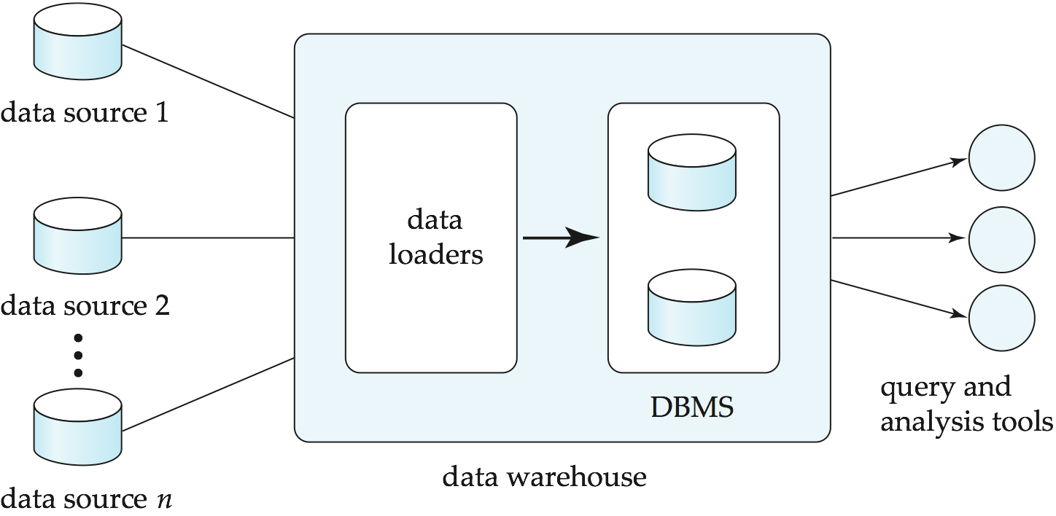
Data Warehousing

Slide 7
Design Issues
When and how to gather data
  Source driven architecture: data sources transmit new information to warehouse, either continuously or periodically (e.g., at night)
  Destination driven architecture: warehouse periodically requests new information from data sources
  Keeping warehouse exactly synchronized with data sources (e.g., using two-phase commit) is too expensive
    Usually OK to have slightly out-of-date data at warehouse
    Data/updates are periodically downloaded form online transaction processing (OLTP) systems.
What schema to use
  Schema integration

Slide 8
More Warehouse Design Issues
Data cleansing
  E.g., correct mistakes in addresses (misspellings, zip code errors)
  Merge address lists from different sources and purge duplicates
How to propagate updates
  Warehouse schema may be a (materialized) view of schema from data sources
What data to summarize
  Raw data may be too large to store on-line
  Aggregate values (totals/subtotals) often suffice
  Queries on raw data can often be transformed by query optimizer to use aggregate values

Slide 9
Warehouse Schemas
Dimension values are usually encoded using small integers and mapped to full values via dimension tables
Resultant schema is called a star schema
  More complicated schema structures
    Snowflake schema: multiple levels of dimension tables
    Constellation: multiple fact tables

Slide 10
Example of Star Schema
time
time_key
day
day_of_the_week
month
quarter
year
item
item_key
item_name
brand
type
supplier_type
Sales Fact Table
time_key
item_key
branch_key
branch
location
location_key
branch_key
branch_name
branch_type
location_key
street
city
province_or_street
country
units_sold
dollars_sold
avg_sales
Measures

Slide 11
Example of Snowflake Schema
time
item
time_key
day
day_of_the_week
month
quarter
year
item_key
item_name
brand
type
supplier_key
supplier
Sales Fact Table
supplier_key
supplier_type
time_key
item_key
branch_key
branch
location
location_key
location_key
street
city_key
branch_key
branch_name
branch_type
units_sold
city
dollars_sold
city_key
city
province_or_street
country
avg_sales
Measures

Slide 12
Example of Fact Constellation
time
time_key
day
day_of_the_week
month
quarter
year
item
Shipping Fact Table
item_key
item_name
brand
type
supplier_type
Sales Fact Table
time_key
time_key
item_key
shipper_key
item_key
branch_key
from_location
branch
location_key
location
to_location
branch_key
branch_name
branch_type
units_sold
location_key
street
city
province_or_street
country
dollars_cost
dollars_sold
units_shipped
avg_sales
shipper
Measures
shipper_key
shipper_name
location_key
shipper_type

Slide 13
Multidimensional Data
Sales volume as a function of product, month, and region
Dimensions: Product, Location, Time
Hierarchical summarization paths
Region
Industry Region Year
Category Country Quarter
Product City Month Week
Office Day
Product
Month

Slide 14
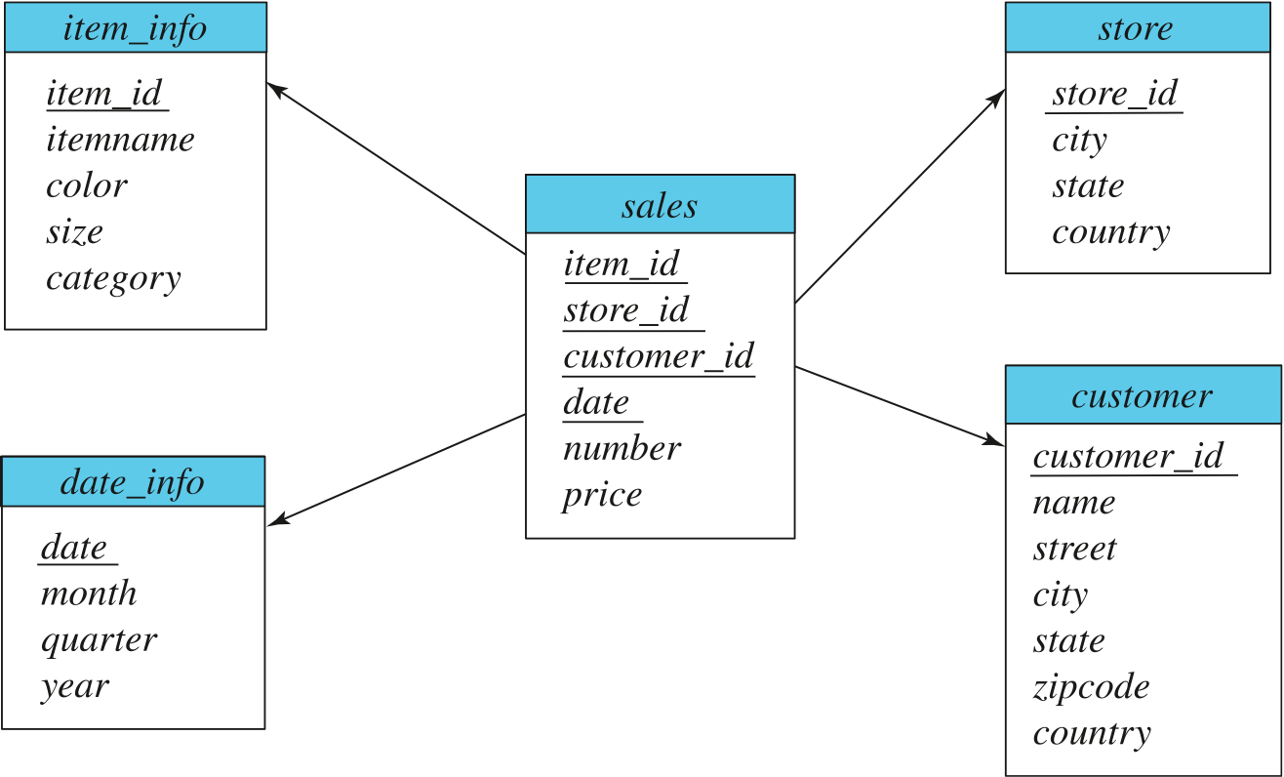
Data Warehouse Schema

Slide 15
Data Mining
Data mining is the process of semi-automatically analyzing large databases to find useful patterns
Prediction based on past history
  Predict if a credit card applicant poses a good credit risk, based on some attributes (income, job type, age, ..) and past history
  Predict if a pattern of phone calling card usage is likely to be fraudulent
Some examples of prediction mechanisms:
  Classification
    Given a new item whose class is unknown, predict to which class it belongs
  Regression formulae
    Given a set of mappings for an unknown function, predict the function result for a new parameter value

Slide 16
Data Mining (Cont.)
Descriptive Patterns
  Associations
    Find books that are often bought by “similar” customers. If a new such customer buys one such book, suggest the others too.
  Associations may be used as a first step in detecting causation
    E.g., association between exposure to chemical X and cancer,
  Clusters
    E.g., typhoid cases were clustered in an area surrounding a contaminated well
    Detection of clusters remains important in detecting epidemics

Slide 17
Classification Rules
Classification rules help assign new objects to classes.
  E.g., given a new automobile insurance applicant, should he or she be classified as low risk, medium risk or high risk?
Classification rules for above example could use a variety of data, such as educational level, salary, age, etc.
  ∀ person P, P.degree = masters and P.income > 75,000
    ⇒ P.credit = excellent
  ∀ person P, P.degree = bachelors and
  (P.income ≥ 25,000 and P.income ≤ 75,000)
  ⇒ P.credit = good
Rules are not necessarily exact: there may be some misclassifications
Classification rules can be shown compactly as a decision tree.

Slide 18
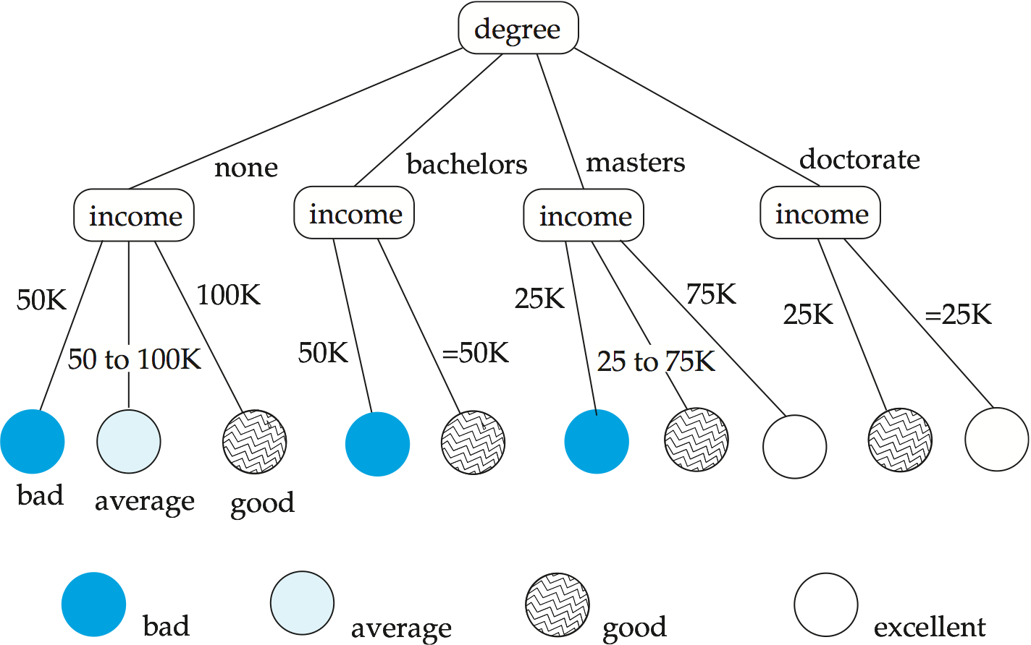
Decision Tree

Slide 19
Construction of Decision Trees
Training set: a data sample in which the classification is already known.
Greedy top down generation of decision trees.
  Each internal node of the tree partitions the data into groups based on a partitioning attribute, and a partitioning condition for the node
  Leaf node:
    all (or most) of the items at the node belong to the same class, or
    all attributes have been considered, and no further partitioning is possible.

Slide 20
Best Splits
Pick best attributes and conditions on which to partition
The purity of a set S of training instances can be measured quantitatively in several ways.
  Notation: number of classes = k, number of instances = |S|,
  fraction of instances in class i = p_{i}.
The Gini measure of purity is defined as
[
Gini (S) = 1 - ∑
  When all instances are in a single class, the Gini value is 0
  It reaches its maximum (of 1 –1 /k) if each class the same number of instances.
k
p²_{i}
i- 1

Slide 21
Best Splits (Cont.)
Another measure of purity is the entropy measure, which is defined as
entropy (S) = – ∑
When a set S is split into multiple sets Si, I=1, 2, …, r, we can measure the purity of the resultant set of sets as:
purity(S₁, S₂, ….., S_{r}) = ∑
The information gain due to particular split of S into S_{i}, i = 1, 2, …., r
Information-gain (S, {S₁, S₂, …., S_{r}) = purity(S ) – purity (S₁, S₂, … S_{r})
k
p_{i}log₂ p_{i}
i- 1
r
|S_{i}|
|S|
purity (S_{i})
i= 1

Slide 22
Best Splits (Cont.)
Measure of “cost” of a split:
Information-content (S, {S₁, S₂, ….., S_{r}})) = – ∑
Information-gain ratio = Information-gain (S, {S₁, S₂, ……, S_{r}})
Information-content (S, {S₁, S₂, ….., S_{r}})
The best split is the one that gives the maximum information gain ratio
r
|S_{i}|
|S|
|S_{i}|
|S|
log₂
i- 1

Slide 23
Decision-Tree Construction Algorithm
  Procedure GrowTree (S )
  Partition (S );
  Procedure Partition (S)
  if ( purity (S ) > δ_{p} or |S| < δ_{s} ) then
  return;
  for each attribute A
  evaluate splits on attribute A;
  Use best split found (across all attributes) to partition
  S into S₁, S₂, …., S_{r},
  for i = 1, 2, ….., r
  Partition (S_{i} );

Slide 24
Other Types of Classifiers
Neural net classifiers are studied in artificial intelligence and are not covered here
Bayesian classifiers use Bayes theorem, which says
p (c_{j} | d ) = p (d | c_{j} ) p (c_{j} )
p ( d )
where
p (c_{j} | d ) = probability of instance d being in class c_{j},
p (d | c_{j} ) = probability of generating instance d given class c_{j},
p (c_{j} ) = probability of occurrence of class c_{j}, and
p (d ) = probability of instance d occuring

Slide 25
Naïve Bayesian Classifiers
Bayesian classifiers require
  computation of p (d | c_{j} )
  precomputation of p (c_{j} )
  p (d ) can be ignored since it is the same for all classes
To simplify the task, naïve Bayesian classifiers assume attributes have independent distributions, and thereby estimate
p (d | c_{j}) = p (d₁ | c_{j} ) * p (d₂ | c_{j} ) * ….* (p (d_{n} | c_{j} )
  Each of the p (d_{i} | c_{j} ) can be estimated from a histogram on d_{i} values for each class c_{j}
    the histogram is computed from the training instances
  Histograms on multiple attributes are more expensive to compute and store

Slide 26
Regression
Regression deals with the prediction of a value, rather than a class.
  Given values for a set of variables, X₁, X₂, …, X_{n}, we wish to predict the value of a variable Y.
One way is to infer coefficients a₀, a₁, a₁, …, a_{n} such that
Y = a₀ + a₁ * X₁ + a₂ * X₂ + … + a_{n} * X_{n}
Finding such a linear polynomial is called linear regression.
  In general, the process of finding a curve that fits the data is also called curve fitting.
The fit may only be approximate
  because of noise in the data, or
  because the relationship is not exactly a polynomial
Regression aims to find coefficients that give the best possible fit.

Slide 27
What is clustering?
Ch. 16
Clustering: the process of grouping a set of objects into classes of similar objects
  Documents within a cluster should be similar.
  Documents from different clusters should be dissimilar.
The commonest form of unsupervised learning
    Unsupervised learning = learning from raw data, as opposed to supervised data where a classification of examples is given
  A common and important task that finds many applications in IR and other places

Slide 28
Cluster Analysis
Finding groups of objects such that the objects in a group will be similar (or related) to one another and different from (or unrelated to) the objects in other groups
Inter-cluster distances are maximized
Intra-cluster distances are minimized

Slide 29
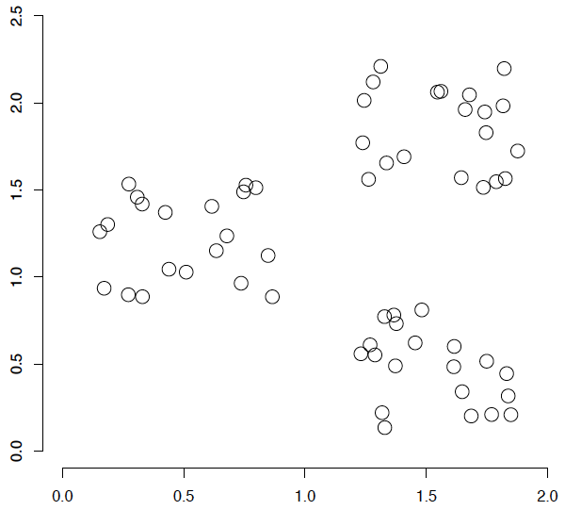
A data set with clear cluster structure
Ch. 16
How would you design an algorithm for finding the three clusters in this case?

Slide 30
Types of Clusterings
A clustering is a set of clusters
Important distinction between hierarchical and partitional sets of clusters
Partitional Clustering
  A division data objects into non-overlapping subsets (clusters) such that each data object is in exactly one subset
Hierarchical clustering
  A set of nested clusters organized as a hierarchical tree

Slide 31
Clustering
Clustering: Intuitively, finding clusters of points in the given data such that similar points lie in the same cluster
Can be formalized using distance metrics in several ways
  Group points into k sets (for a given k) such that the average distance of points from the centroid of their assigned group is minimized
    Centroid: point defined by taking average of coordinates in each dimension.
  Another metric: minimize average distance between every pair of points in a cluster
Has been studied extensively in statistics, but on small data sets
  Data mining systems aim at clustering techniques that can handle very large data sets
  E.g., the Birch clustering algorithm (more shortly)

Slide 32
Hierarchical Clustering
Example from biological classification
  (the word classification here does not mean a prediction mechanism)
  chordata
  mammalia reptilia
  leopards humans snakes crocodiles
Other examples: Internet directory systems (e.g., Yahoo, more on this later)
Agglomerative clustering algorithms
  Build small clusters, then cluster small clusters into bigger clusters, and so on
Divisive clustering algorithms
  Start with all items in a single cluster, repeatedly refine (break) clusters into smaller ones

Slide 33

Clustering Algorithms
Clustering algorithms have been designed to handle very large datasets
E.g., the Birch algorithm
  Main idea: use an in-memory R-tree to store points that are being clustered
  Insert points one at a time into the R-tree, merging a new point with an existing cluster if is less than some δ distance away
  If there are more leaf nodes than fit in memory, merge existing clusters that are close to each other
  At the end of first pass we get a large number of clusters at the leaves of the R-tree
    Merge clusters to reduce the number of clusters

